Slide 1
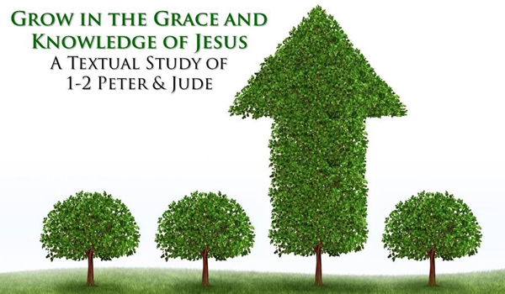
Growing As Children of Light
Notes:
This graphic came from Jason Hardin. I am certain have I have used notes from Mark Copeland’s EO series, Randy Yerby, Aaron Fleenor and other in making these powerpoints. Further, images have been used from the internet that remain property of their owners. This can not be sold or used commercially. It can only be used for classroom (Bible class) purposes.

Slide 2
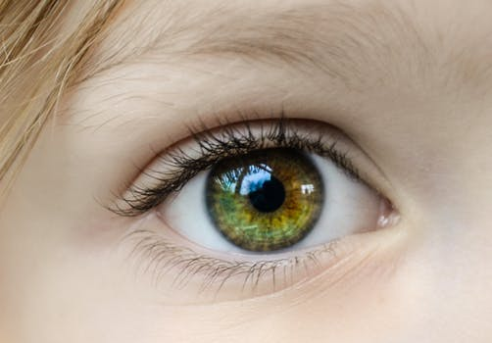

Eyeing Second Peter
Building On God’s Promises
Escaping the Corruption in the World
Partaking of the Divine Nature
Week 7: Patience
Notes:
In addition to some material used from Mark Copeland’s EO series, there is also material contributed by RS Yerby in this powerpoint,

Slide 3

Eyeing Second Peter
Weekly study plan:
Read 2 Peter once a week
Work on the memory verse by reading it carefully aloud at least eleven times this week
Any study on next weeks topic in the text from next week’s topic: godliness

Slide 4
Memory Passage: 2 Peter 1:3-4
According as his divine power hath given unto us all things that pertain unto life and godliness,
through the knowledge of him that hath called us to glory and virtue:
Whereby are given unto us exceeding great and precious promises:
that by these ye might be partakers of the divine nature,
having escaped the corruption that is in the world through lust.

Slide 5
Remembering Second Peter
Blindness and Myopia Control
Eyes Full of Adultery
Twinkling of an Eye
Holiness – Heresy – Hope
Cultivate Christian Character
Condemnation of false teachers
Confidence in Christ’s return
Read 10X, 10 Classes, Mechanism, Memory verse

Slide 6
Introduction:
Growing in the knowledge of Jesus Christ requires developing a Christ-like character, partaking of the divine nature (holiness).
This requires all diligence to develop seven “graces”, in our lives, in conjunction with each other.
2 Peter 1:5-10 ⁵ And beside this, giving all diligence, add to your faith virtue; and to virtue knowledge;⁶ And to knowledge temperance; and to temperance patience; and to patience godliness;⁷ And to godliness brotherly kindness; and to brotherly kindness charity.⁸ For if these things be in you, and abound, they make you that ye shall neither be barren nor unfruitful in the knowledge of our Lord Jesus Christ.⁹ But he that lacketh these things is blind, and cannot see afar off, and hath forgotten that he was purged from his old sins.¹⁰ Wherefore the rather, brethren, give diligence to make your calling and election sure: for if ye do these things, ye shall never fall:

Slide 7
Introduction:
Overview of 2 Peter and graces (Myopia Control)
Escaping corruption in the world through lust
Diligence
Build on “faith”.
Virtue or moral excellence
Knowledge
Self-Control
“add” – epichoregeo
Patience

Slide 8
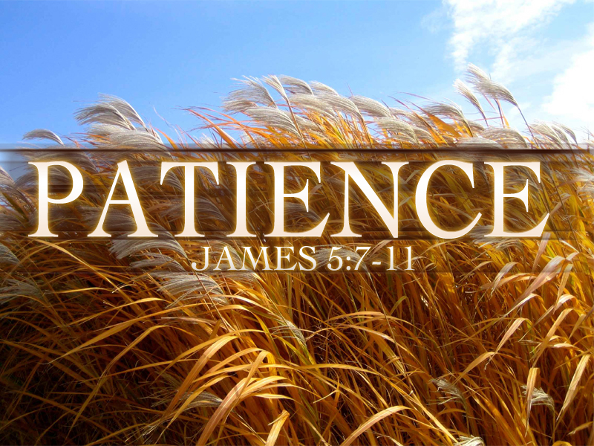
James 5:7-11 Be Patient!
Myopia and Blindness Control:
Until The Lord Comes,
In The Face of Trials,
And You Will Be Blessed.
Notes:
Re-Read James 5:7-8
Patience testers
Long lines at the grocery store
Having someone pull out in front of you on the highway and then drive extremely slow
Waiting for hours at the doctors office
Slow service at McDonald’s
Long winded preachers who talk way too long
What is patience?
Patience is the ability to put up with people you’d like to put down. Ulrike Ruffert Patience is accepting a difficult situation without giving God a deadline to remove it. Bill Gothard "Patience is a inner calmness that comes from the knowledge that God is in control.“
The original Greek term translated “patience” is a compound word taken from two other words. One word means “long,” or “far.” The other means “anger,” or “wrath.” Putting it together we come up with the literal translation of “long-angered.” You’ve all heard the expression, “short-tempered”? That is a description of a person easily angered. Well, the expression for patience is “long-tempered.”
Be Patient…
Until the Lord Comes
In the face of trials
And you will be blessed

Slide 9
What is “Patience”? Difference from “Perseverance”?
Greek 5281. hupomoné
Quality of being patient, endurance of difficult situation
Associated and sometimes translated as “perseverance”
Perseverance is steadfastness, continuing a course of action without regard to discouragement or opposition

Slide 10
Defining Patience
What causes impatience? Doctor office waits, traffic, slow restaurant service, long winded preachers, our spouse
The original Greek term translated “patience” is a compound word taken from two other words. One word means “long,” or “far.” The other means “anger,” or “wrath.” Putting it together we come up with the literal translation of “long-angered.” You’ve all heard the expression, “short-tempered”? That is a description of a person easily angered. Well, the expression for patience is “long-tempered.”
Patience is a inner calmness that comes from the knowledge that God is in control.
Human quotes: (So much written…)
“Patience is the ability to put up with people you’d like to put down.” Ulrike Ruffert
“Patience is accepting a difficult situation without giving God a deadline to remove it.” Bill Gothard
Be Patient…blessed
Until the Lord Comes
In the face of trials

Slide 11
James 5:7-11 Be patient, therefore, brothers, until the coming of the Lord. See how the farmer waits for the precious fruit of the earth, being patient about it, until it receives the early and the late rains. 8 You also, be patient. Establish your hearts, for the coming of the Lord is at hand. 9 Do not grumble against one another, brothers, so that you may not be judged; behold, the Judge is standing at the door. 10 As an example of suffering and patience, brothers, take the prophets who spoke in the name of the Lord. 11 Behold, we consider those blessed who remained steadfast. You have heard of the steadfastness of Job, and you have seen the purpose of the Lord, how the Lord is compassionate and merciful.
Notes:
Until the Coming of the Lord
Why until then – B/c there are going to be frustrating things as long as there is still sin in our environment.
The paradox of Christianity is that the more we love God the more uncomfortable we are bound to be here in a world stained with our sins.
What Good Does Patience Produce?
I don’t know about all of you but for me patience usually mean NOT acting on an impulse to do or say something I believe will force a situation to improve. Someone is being hard-hearted we’d just like to “give them a piece of our mind” and let them know how it really is. But because I know God wants me to speak with love, I have to exercise patience and remember that no one – especially not me – is perfect.
Those times that we don’t show patience are when we feel like “I just had to do something” or “I just had to say something”
Jesus certainly illustrated vividly for us that there are times for immediate and decisive action, but there are also times for patience because Patience can also produce the result you intend. James reminds us of the lessons God has placed in nature to teach us about spiritual matters when he points out the patience of the farmer.
READ PSALM 130:5-8
“Waiting for the Lord.” He states, “…is an Old Testament way of describing the opposite of impatience. Waiting for the Lord is the opposite of running ahead of the Lord and it’s the opposite of bailing out on the Lord. It is staying at your appointed place while he says stay, or it’s going at his appointed pace while he says go. It’s not impetuous and its not despairing.”

Slide 12
Be Patient: Until The Lord Comes (7-8)
Be Patient: In The Face of Trials (9-10)
Be Patient: And You Will Be Blessed
Notes:
12
Until the Coming of the Lord
Why until then – B/c there are going to be frustrating things as long as there is still sin in our environment.
The paradox of Christianity is that the more we love God the more uncomfortable we are bound to be here in a world stained with our sins.
What Good Does Patience Produce?
I don’t know about all of you but for me patience usually mean NOT acting on an impulse to do or say something I believe will force a situation to improve. Someone is being hard-hearted we’d just like to “give them a piece of our mind” and let them know how it really is. But because I know God wants me to speak with love, I have to exercise patience and remember that no one – especially not me – is perfect.
Those times that we don’t show patience are when we feel like “I just had to do something” or “I just had to say something”
Jesus certainly illustrated vividly for us that there are times for immediate and decisive action, but there are also times for patience because Patience can also produce the result you intend. James reminds us of the lessons God has placed in nature to teach us about spiritual matters when he points out the patience of the farmer.
READ PSALM 130:5-8
“Waiting for the Lord.” He states, “…is an Old Testament way of describing the opposite of impatience. Waiting for the Lord is the opposite of running ahead of the Lord and it’s the opposite of bailing out on the Lord. It is staying at your appointed place while he says stay, or it’s going at his appointed pace while he says go. It’s not impetuous and its not despairing.”

Slide 13
Why is Job Associated With Patience?

Slide 14

Why is Job associated with patience?
Job 19:25-27 For I know that my Redeemer lives, and at the last he will stand upon the earth. 26 And after my skin has been thus destroyed, yet in my flesh I shall see God, 27 whom I shall see for myself, and my eyes shall behold, and not another. My heart faints within me!
Job went from healthy, wealthy, and upright family man to a diseased, impoverished man burying his ten children.
This was done with God’s definite permission.
“In all this, Job did not sin in what he said.” - Job 2:10
There is no hint of demandingness (exigent)
Job is hit with a series of devastations:
Oxen and donkey are killed
Servants are killed
Sheep are killed
More servants are killed
Thieves steal his camels and kill more of his servants
Job’s sons and daughters are killed when a house collapses.
God permits Satan to cause Job to break out in sores.
Notes:
14
Until the Coming of the Lord
Why until then – B/c there are going to be frustrating things as long as there is still sin in our environment.
The paradox of Christianity is that the more we love God the more uncomfortable we are bound to be here in a world stained with our sins.
What Good Does Patience Produce?
I don’t know about all of you but for me patience usually mean NOT acting on an impulse to do or say something I believe will force a situation to improve. Someone is being hard-hearted we’d just like to “give them a piece of our mind” and let them know how it really is. But because I know God wants me to speak with love, I have to exercise patience and remember that no one – especially not me – is perfect.
Those times that we don’t show patience are when we feel like “I just had to do something” or “I just had to say something”
Jesus certainly illustrated vividly for us that there are times for immediate and decisive action, but there are also times for patience because Patience can also produce the result you intend. James reminds us of the lessons God has placed in nature to teach us about spiritual matters when he points out the patience of the farmer.
READ PSALM 130:5-8
“Waiting for the Lord.” He states, “…is an Old Testament way of describing the opposite of impatience. Waiting for the Lord is the opposite of running ahead of the Lord and it’s the opposite of bailing out on the Lord. It is staying at your appointed place while he says stay, or it’s going at his appointed pace while he says go. It’s not impetuous and its not despairing.”

Slide 15
Why Should We Want Patience?

Slide 16
Desideratum for Patience
Needed for Elders
Titus 1:8 (ESV) but hospitable, a lover of good, self-controlled, upright, holy, and disciplined.
Christians should develop patience
2 Timothy 2:22-26 So flee youthful passions and pursue righteousness, faith, love, and peace, along with those who call on the Lord from a pure heart. 23 Have nothing to do with foolish, ignorant controversies; you know that they breed quarrels. 24 And the Lord's servant must not be quarrelsome but kind to everyone, able to teach, patiently enduring evil, 25 correcting his opponents with gentleness. God may perhaps grant them repentance leading to a knowledge of the truth, 26 and they may come to their senses and escape from the snare of the devil, after being captured by him to do his will.
Hebrews 12:1-3 Therefore, since we are surrounded by so great a cloud of witnesses, let us also lay aside every weight, and sin which clings so closely, and let us run with endurance the race that is set before us, 2 looking to Jesus, the founder and perfecter of our faith, who for the joy that was set before him endured the cross, despising the shame, and is seated at the right hand of the throne of God.

Slide 17
Detriments of Impatience
Esau Genesis 25:29-34 Once when Jacob was cooking stew, Esau came in from the field, and he was exhausted. 30 And Esau said to Jacob, “Let me eat some of that red stew, for I am exhausted!” (Therefore his name was called Edom.) 31 Jacob said, “Sell me your birthright now.” 32 Esau said, “I am about to die; of what use is a birthright to me?” 33 Jacob said, “Swear to me now.” So he swore to him and sold his birthright to Jacob. 34 Then Jacob gave Esau bread and lentil stew, and he ate and drank and rose and went his way. Thus Esau despised his birthright.
Demas 2 Timothy 4:10 For Demas, in love with this present world, has deserted me and gone to Thessalonica. Crescens has gone to Galatia
What is the difference between patience and indifference/apathy?

Slide 18
How do we develop patience?

Slide 19
Developing Patience
Romans 5:1-5 Therefore, since we have been justified by faith, we have peace with God through our Lord Jesus Christ. 2 Through him we have also obtained access by faith into this grace in which we stand, and we rejoice in hope of the glory of God. 3 Not only that, but we rejoice in our sufferings, knowing that suffering produces endurance, 4 and endurance produces character, and character produces hope, 5 and hope does not put us to shame, because God's love has been poured into our hearts through the Holy Spirit who has been given to us.
James 1:2-4 Count it all joy, my brothers, when you meet trials of various kinds, 3 for you know that the testing of your faith produces steadfastness. 4 And let steadfastness have its full effect, that you may be perfect and complete, lacking in nothing.

Slide 20
Developing Patience
Romans 8:18-25 For I consider that the sufferings of this present time are not worth comparing with the glory that is to be revealed to us. 19 For the creation waits with eager longing for the revealing of the sons of God. 20 For the creation was subjected to futility, not willingly, but because of him who subjected it, in hope 21 that the creation itself will be set free from its bondage to corruption and obtain the freedom of the glory of the children of God. 22 For we know that the whole creation has been groaning together in the pains of childbirth until now. 23 And not only the creation, but we ourselves, who have the firstfruits of the Spirit, groan inwardly as we wait eagerly for adoption as sons, the redemption of our bodies. 24 For in this hope we were saved. Now hope that is seen is not hope. For who hopes for what he sees? 25 But if we hope for what we do not see, we wait for it with patience.
Romans 15:4-6 For whatever was written in former days was written for our instruction, that through endurance and through the encouragement of the Scriptures we might have hope. 5 May the God of endurance and encouragement grant you to live in such harmony with one another, in accord with Christ Jesus, 6 that together you may with one voice glorify the God and Father of our Lord Jesus Christ.

Slide 21
What are the PROMISES of patience?

Slide 22
Promises of Patience
Hebrews 6:9-12 Though we speak in this way, yet in your case, beloved, we feel sure of better things—things that belong to salvation. 10 For God is not unjust so as to overlook your work and the love that you have shown for his name in serving the saints, as you still do. 11 And we desire each one of you to show the same earnestness to have the full assurance of hope until the end, 12 so that you may not be sluggish, but imitators of those who through faith and patience inherit the promises.
2 Peter 3:9-15 The Lord is not slow to fulfill his promise as some count slowness, but is patient toward you, not wishing that any should perish, but that all should reach repentance. 10 But the day of the Lord will come like a thief, and then the heavens will pass away with a roar, and the heavenly bodies will be burned up and dissolved, and the earth and the works that are done on it will be exposed. 11 Since all these things are thus to be dissolved, what sort of people ought you to be in lives of holiness and godliness, 12 waiting for and hastening the coming of the day of God, because of which the heavens will be set on fire and dissolved, and the heavenly bodies will melt as they burn! 13 But according to his promise we are waiting for new heavens and a new earth in which righteousness dwells.14 Therefore, beloved, since you are waiting for these, be diligent to be found by him without spot or blemish, and at peace. 15 And count the patience of our Lord as salvation, just as our beloved brother Paul also wrote to you according to the wisdom given him,

Slide 23
Promises of Patience
There are going to be frustrating things as long as there is still sin in our environment.
“The paradox of Christianity is that the more we love God the more uncomfortable we are bound to be here in a world stained with our sins.” – RS Yerby
God wants me to speak with love, and exercise patience (vs a piece of my mind)
Jesus certainly illustrated vividly for us that there are times for immediate and decisive action, but there are also times for patience.

Slide 24
Promises of Patience
Psalms 130:5-8 I wait for the Lord, my soul waits, and in his word I hope; 6 my soul waits for the Lord more than watchmen for the morning, more than watchmen for the morning. 7 O Israel, hope in the Lord! For with the Lord there is steadfast love,and with him is plentiful redemption. And he will redeem Israel from all his iniquities.
“Waiting for the Lord” is an Old Testament way of describing the opposite of impatience. Waiting for the Lord is the opposite of running ahead of the Lord and it’s the opposite of bailing out on the Lord. It is staying at your appointed place while he says stay, or it’s going at his appointed pace while he says go. It’s not impetuous and its not despairing.
Demonstrated by God. Psalms 103:6-19

Slide 25
Promises of Patience
Tempers
A lack of self-control and over reacting emotion are Satan’s tool of temptation
Satan’s lie is that if we just have this release then we will be over it. Flaring tempers often stir up rather than dissapate strife.
Slow to anger and patience often calm disputes.
Eg the horn and the stalled engine “Would you see if you could start my car and I’ll blow the horn for you this time.”
James 1:19-20 Know this, my beloved brothers: let every person be quick to hear, slow to speak, slow to anger; 20 for the anger of man does not produce the righteousness of God.
James 1:12-15 Blessed is the man who remains steadfast under trial, for when he has stood the test he will receive the crown of life, which God has promised to those who love him. 13 Let no one say when he is tempted, “I am being tempted by God,” for God cannot be tempted with evil, and he himself tempts no one. 14 But each person is tempted when he is lured and enticed by his own desire. 15 Then desire when it has conceived gives birth to sin, and sin when it is fully grown brings forth death.
No matter the trial, we need to face them with patience. Let’s commit to God’s method rather than adopting the short-sighted “solution” of Satan’s tool.
Christians grow with patience. “Intentional sabotage”

Slide 26
James 5:7-11 Be Patient!
Until The Lord Comes,
In The Face of Trials,
And You Will Be Blessed.
Notes:
Re-Read James 5:7-8
“One day a man was to meet his wife downtown and spend some time shopping with her. He waited patiently for 15 minutes. Then he waited impatiently for 15 minutes more.
After that, he became angry. Seeing one of those photograph booths nearby (the kind that accepts coins into a slot and takes four shots while you pose on a small bench), he had an idea. He assumed the most ferocious expression he could manage, which wasn’t difficult under the circumstances, and in a few moments he was holding four small prints that shocked even him!
He wrote his wife’s name on the back of the photographs and handed them to a clerk behind the desk. "If you see a small, dark lady with brown eyes and an apologetic expression, apparently looking for someone, would you please give her this?" he said.
He then returned to his office content that, if a picture is worth a thousand words, then four photos must be a full-blown lecture! His wife saved those pictures. She carries them in her purse now. Shows them to anyone who asks if she is married.” [Sermon Illustrator. Patience – “Wait Training” www.sermonillustrator.org]

Slide 27
Longsuffering
Numbers 13: 30 – 14:12
What Longsuffering is not? What is Longsuffering?
In a desire to be kind, to give each person a chance…
Ecclesiastes 8:11
“Shouldn’t we be showing patience?”
Longsuffering is not endless tolerance - 2 Peter 3:9
2 Peter 3:7
Some people misapply the longsuffering of God.
Notes:
Complaining – I had to chuckle when I read the story of a man whose car stalled in heavy traffic just as the light turned green. All his efforts to start the engine failed. You know what happened, he was trying frantically to start the car and a hundred other cars behind him were laying on their horns. In spite of his best efforts the car wouldn’t start through the entire time the light was green. The people behind him never slacked off the horn. He finally got out of his car and walked back to the driver right behind him who had been laying on the horn even though he could hear the man trying to start the engine. He politely said to the man, "I’m sorry, but I can’t seem to get my car started. Would you mind to try starting my car and I’ll blow the horn for you this time." (--James S. Hewett, Illustrations Unlimited (Wheaton: Tyndale House Publishers, Inc, 1988), p. 396.)
Worldly Thinking
There is even a church in Florida that advertises a 22 minute service. That’s right. They promise that 22 minutes after the service begins you will be dismissed. The music is fast. . . The prayers are quick. . . The sermons are only 8 minutes long. Now don’t get your hopes up, it’s not going to happen here!
Raging Tempers
Here, a lack of self-control and over reacting emotions are Satan’s tool of temptation for Christians to let their patience slip and their hearts rage.
Satan’s Lie is that if we just have this release, this emotional explosion that then we will be “over it” but that is simply not true. When tempers flare, strife is stirred up rather than dissipated. It is those who are slow to anger. Those with a Patient heart, that are able to calm a dispute.
No matter what the trials are – We need to face them with Patience that reflects our commitment for God’s method of dealing with them rather than adopting Satan’s short-sighted solutions. (which are not really solutions at all.)
We need a patient tongue, patient mind, patient eyes, and a patient heart so that our relationship with God grows stronger and we are able to walk in His ways.

Slide 28
Longsuffering
Numbers 13: 30 – 14:12
Longsuffering is not equally applied
God shows great patience with his people - Psalm 86:15-16
BUT, there is a limit - Exodus 34:5-7
What’s the difference?
Longsuffering does not mean sin is not punished – Numbers 14:18-23
What is Longsuffering?
The goal of longsuffering is to bring about repentance.
Longsuffering is our chance for salvation.
Notes:
Complaining – I had to chuckle when I read the story of a man whose car stalled in heavy traffic just as the light turned green. All his efforts to start the engine failed. You know what happened, he was trying frantically to start the car and a hundred other cars behind him were laying on their horns. In spite of his best efforts the car wouldn’t start through the entire time the light was green. The people behind him never slacked off the horn. He finally got out of his car and walked back to the driver right behind him who had been laying on the horn even though he could hear the man trying to start the engine. He politely said to the man, "I’m sorry, but I can’t seem to get my car started. Would you mind to try starting my car and I’ll blow the horn for you this time." (--James S. Hewett, Illustrations Unlimited (Wheaton: Tyndale House Publishers, Inc, 1988), p. 396.)
Worldly Thinking
There is even a church in Florida that advertises a 22 minute service. That’s right. They promise that 22 minutes after the service begins you will be dismissed. The music is fast. . . The prayers are quick. . . The sermons are only 8 minutes long. Now don’t get your hopes up, it’s not going to happen here!
Raging Tempers
Here, a lack of self-control and over reacting emotions are Satan’s tool of temptation for Christians to let their patience slip and their hearts rage.
Satan’s Lie is that if we just have this release, this emotional explosion that then we will be “over it” but that is simply not true. When tempers flare, strife is stirred up rather than dissipated. It is those who are slow to anger. Those with a Patient heart, that are able to calm a dispute.
No matter what the trials are – We need to face them with Patience that reflects our commitment for God’s method of dealing with them rather than adopting Satan’s short-sighted solutions. (which are not really solutions at all.)
We need a patient tongue, patient mind, patient eyes, and a patient heart so that our relationship with God grows stronger and we are able to walk in His ways.

